Slide 1
Vidyo Certified Deployment and Support Engineer Training
Day One v3.x.x
Many of the products and features described herein remain in varying stages of development and will be offered on a when-and-if available basis. The product plans, specifications, and descriptions are provided for information only and are subject to change without notice, and are provided without warranty of any kind, express or implied. Vidyo reserves the right to modify future product plans at any time.

Slide 2
FAQ
To help us maintain our schedule please ask your sales rep/engineer about
Feature requests
Roadmap questions
Pricing
Connectivity: SSID – VidyoTraining Password – Training@Vidyo
If you are having an issue please let us know!
Restroom
Kitchen/Food
“Many of the products and features described herein remain in varying stages of development and will be offered on a when-and-if available basis. The product plans, specifications, and descriptions are provided for information only and are subject to change without notice, and are provided without warranty of any kind, express or implied. Vidyo reserves the right to modify future product plans at any time.”

Slide 3

Day 1 - Agenda
Topic | Lab Exercise | Time
Introduction |  | 9:00 - 9:30 AM
Training Account / VPN Setup |  | 9:30 – 10:15 AM
VidyoConferencing Overview |  | 10:15 – 11:00 AM
Break |  | 11:00 - 11:15 AM
VidyoPortal Initial Setup |  | 11:15 AM - 12:30 PM
Lunch |  | 12:30 – 1:15 PM
VidyoPortal & VidyoDesktop Features |  | 1:15 – 2:30 PM
Break |  | 2:30 – 2:45 PM
VidyoPortal Administration Features |  | 2:45 – 3:15 PM
VidyoRouter Initial Setup |  | 3:15 – 4:00 PM
VidyoProxy Setup |  | 4:00 – 5:00 PM

Slide 4

VC-DSE Exam
When: End of Day 3 (Please let us know if you are leaving early!)
Format: Mix of 50 Questions
Time Limit: 65 Minutes
Allowed Attempts: 2 Times
Passing Score: 70%

Slide 5
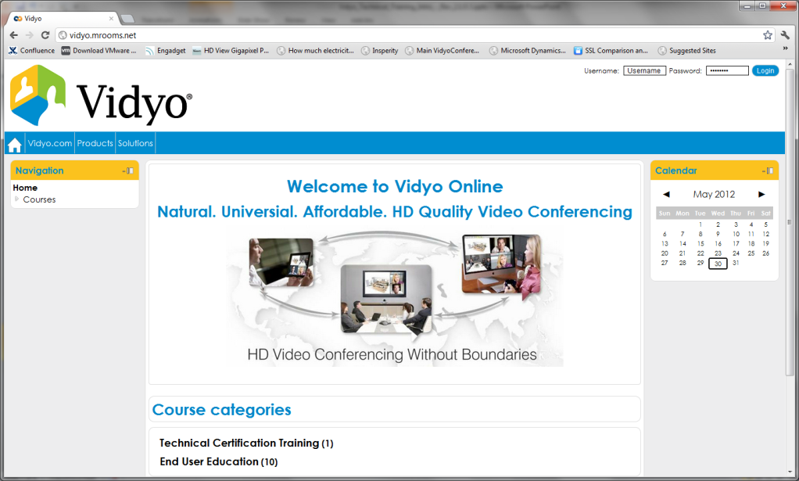
Training Site: training.vidyo.com
Online Learner Management System (LMS)
Automatic registration
Self-service and self-guided services
Content available in one easy to use system
Consolidates training initiatives on a scalable web-based platform
Self-paced Online Training
Course Materials and Videos

Slide 6
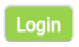
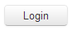
Training Materials
Logging into the Training Site
Navigate to training.vidyo.com
Click on the top right
Enter your credentials and click
Accessing the Course
Once you’ve signed in, click ‘Find Courses’
Click ‘Technical Training’
Click the ‘VC-DSE Course’ Link
When prompted, please use the following enrollment key: vcDSE
Scroll down and you will see a link to download the training materials.

Slide 7
Course Materials
Course materials are provided and include the following:
Course presentation content in PPS and PDF format
Lab Exercise Information
Technical Notes
Utilities
Training License Files
Additional Documentation

Slide 8
Course Training Objectives
Install and manage the complete Vidyo Solution
VidyoPortal
VidyoRouter
VidyoGateway
VidyoReplay
Support VidyoDesktop and VidyoRoom users
Troubleshoot common issues
Deployment Options
VidyoCloud
Common Deployment Architectures
LDAP/Active Directory Authentication
Advanced Topics – Available on training.vidyo.com

Slide 9
Virtual Training Lab Environment
Each student has access to their own virtual environment
VidyoPortal
VidyoRouter
VidyoGateway
VidyoReplay
Students also have access to the following Vidyo products and accessories
VidyoRoom system
Camera
USB speakerphone

Slide 10

Course Benefits
Ability to provide Vidyo deployment/installation services
Certified to provide Tier 1 support services to your customers
Obtain hands-on experience configuring and deploying Vidyo infrastructure
9.5 infoComm CTS (Certified Technology Specialist) Renewal Units

Slide 11
VidyoConferencing Technical Overview

Slide 12
Day 1 - Training Objectives
Explain the benefits of Vidyo’s implementation of H.264 SVC vs. traditional AVC
Describe the roles of each component in the Vidyo Conferencing portfolio
List and describe Vidyo’s licensable features and resources
Describe Vidyo bandwidth utilization and recommendations
Configure and deploy
VidyoPortal
VidyoRouter
VidyoProxy
Notes:
Video 1

Slide 13
Video Conferencing Terminology – H.264 Codecs
Vidyo uses the superior compression method, H.264/MPEG-4 SVC, to achieve high quality, resilient and natural telepresence experiences over any network
Video Compression Types
H.264/MPEG-4 AVC (Advanced Video Coding)
Uses a single and less resilient video stream that is sensitive to bandwidth fluctuations and packet loss
H.264/MPEG-4 SVC - Annex G Extension (Scalable Video Coding)
Uses multiple layers (Vidyo uses up to three) to independently adjusts each layer’s frame rate, quality and resolution in real-time. By monitoring bandwidth fluctuations/packet loss, window size, and/or available CPU resources by the client

Slide 14

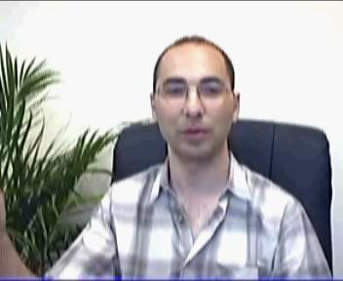








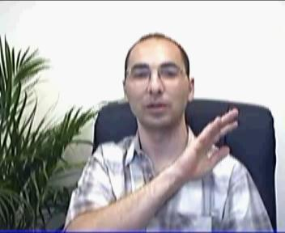

AVC - Single Layer vs. SVC - Multi-Layer
Single Layer (AVC)
Significant Impact
Multi-layer (SVC)
Minor or No Impact
Enhancement Layer
Base Layer
Notes:
Video 1

Slide 15
AVC - Single Layer vs. SVC - Multi-Layer
AVC - Single Layer
Each frame depends on the former one, loss can’t be tolerated
Rate shaping, change of resolution requires complex hardware and introduces delay
SVC - Multi-Layer
Quality is built from multiple layers, highly resilient to packet loss allowing video conference over any network, anywhere.
Resolution, Frame Rate, and Bandwidth are scaled in real-time by the VidyoRouter
No transcoding = Very Low Latency
Notes:
Video 1

Slide 16
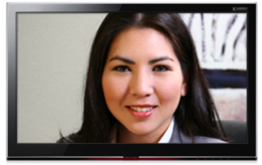

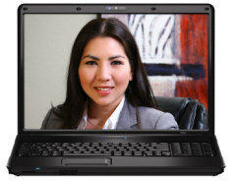
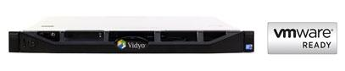
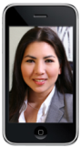
Dynamically Adapts to User Environment
High Resolution Layer
Base Layer
High Resolution - High Frame Ra
Source
High Resolution - High Frame Rate
2 Mbps
High Resolution Layer
High Resolution Layer
VidyoRouter™
Base Layer
Base Layer
Medium Resolution - Medium Frame Rate
Medium Resolution - Medium Frame Rate
500 Kbps
Base Layer
3G/4G
Low Bandwidth
Low Resolution - Low Frame Rate
Low Resolution - Low Frame Rate
Vidyo’s Adaptive Video LayeringTM does not require a network decision.
Notes:
Video 1

Slide 17
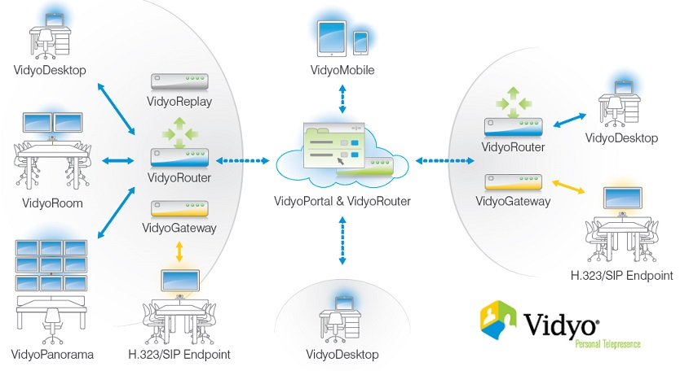
Vidyo - Infrastructure Overview
Notes:
Allen wants to switch sides
Add panorama to end points

Slide 18
VidyoConferencing Endpoints
Notes:
Video 2

Slide 19
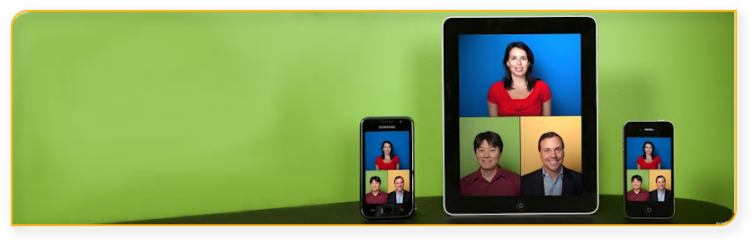
Vidyo Endpoints - VidyoMobile
VidyoMobile turns any iOS or Android device into a high definition VidyoConferencing system
Supports point-to-point and multipoint conferences with content sharing
Works over Wi-Fi, 3G, and 4G wireless networks
VidyoMobile is free to download from Apple Store, Play Store, and Amazon Android Store
Requires a VidyoPortal connection or guest link
Notes:
Video 2

Slide 20
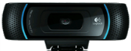
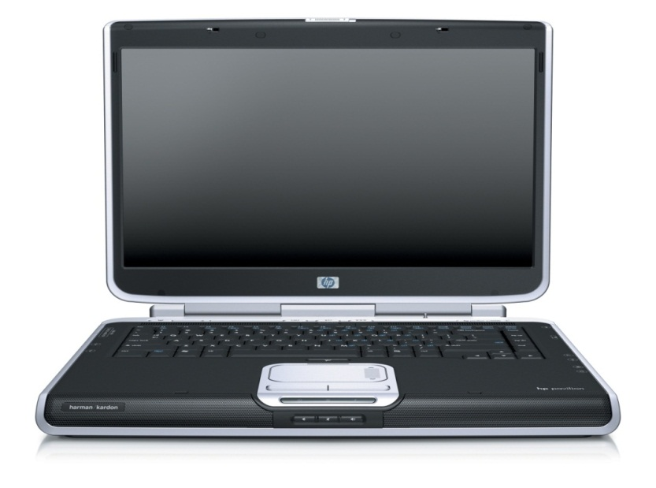

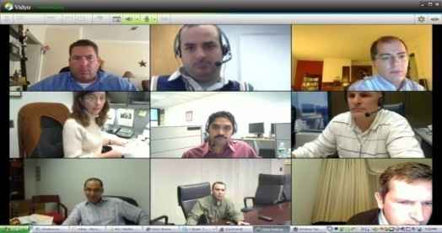

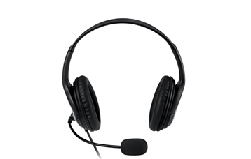
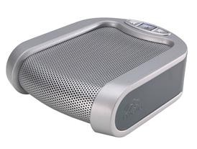
Vidyo Endpoints - VidyoDesktop
Supports point-to-point and multipoint conferences with content sharing
Encodes up to HD 1080p@30fps (With capable hardware)
Decodes up to HD 1440p@30fps (With capable hardware)
Downloadable and managed through VidyoPortal
Supports Windows, Mac and Linux
Notes:
Video 2

Slide 21
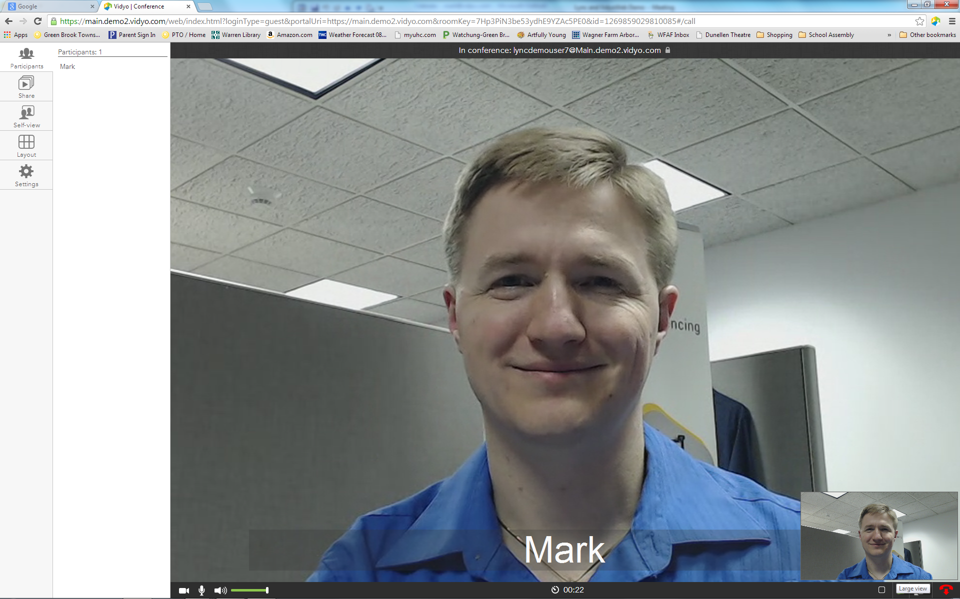
Vidyo Endpoints - VidyoWeb
Supports point-to-point and multipoint conferences with content sharing
Encodes up to HD 720p@30fps (With capable hardware)
Decodes up to HD 720p@30fps, max screen 2880x1800 pixels (With capable hardware)
Downloadable and managed through VidyoPortal
Supports Windows and Mac
Notes:
Video 2

Slide 22

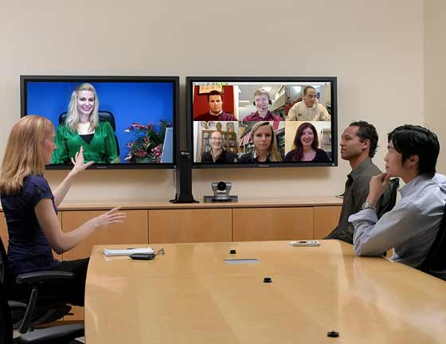
Vidyo Endpoints - VidyoRoom
Stunning HD quality conference room solution
Works over regular internet without the need for dedicated networks
Compatible with VidyoDesktop and VidyoMobile via VidyoPortal
Works seamlessly with legacy video conferencing systems via VidyoGateway
Easy to deploy
Notes:
Video 2

Slide 23
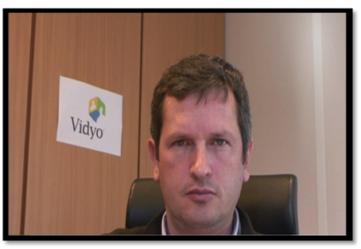
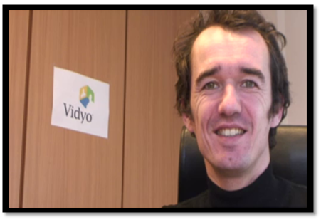
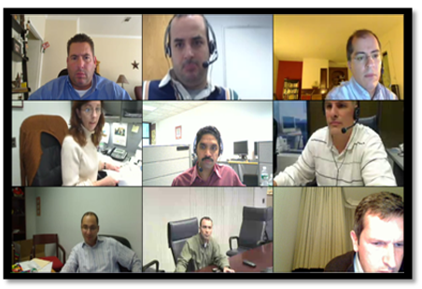

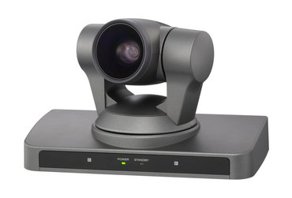
Vidyo Endpoints - VidyoRoom
MULTIPLE VGA
HD
HD
SCREEN SHARE
(HD 230 model)
Hardware appliance
Encode up to 1080p@30fps
Decode up to 1080p@60fps - Dual
HD PTZ Camera
Notes:
Video 2

Slide 24
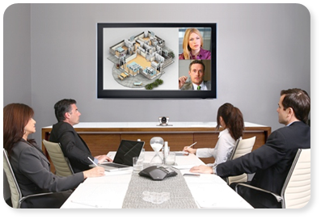
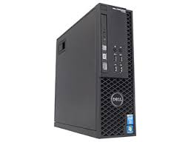
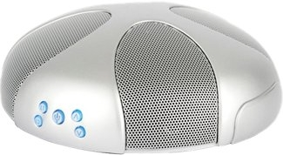
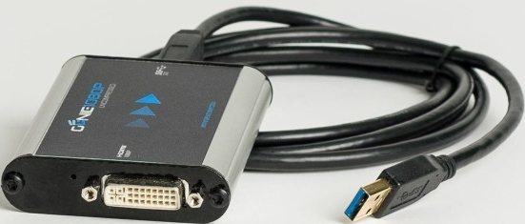
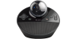
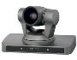
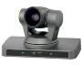
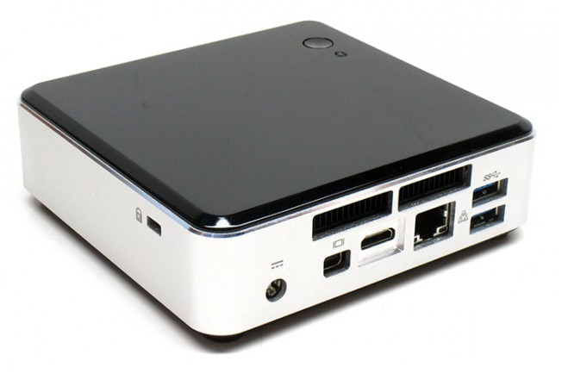
VidyoRoom - 3.0 Portfolio
 | HD-230 | HD-100D | HD-40B
HD Encoding | 1080p30 | 720p30 | 720p30
HD Decoding | 1080p60 x Dual Screen | 1080p30 | 1080p30
Display 1 | Content and/or Up to 16 participants | Content and/or Up 8 participants | Content and/or Up 8 participants
Display 2 (optional) | Content and/or Up to 16 participants | Content Only | Content Only
Remote Content Sharing | 1080p30 (native) | 720p15 (requires Pro Pack) | 720p5 (requires Pro Pack)

Slide 25
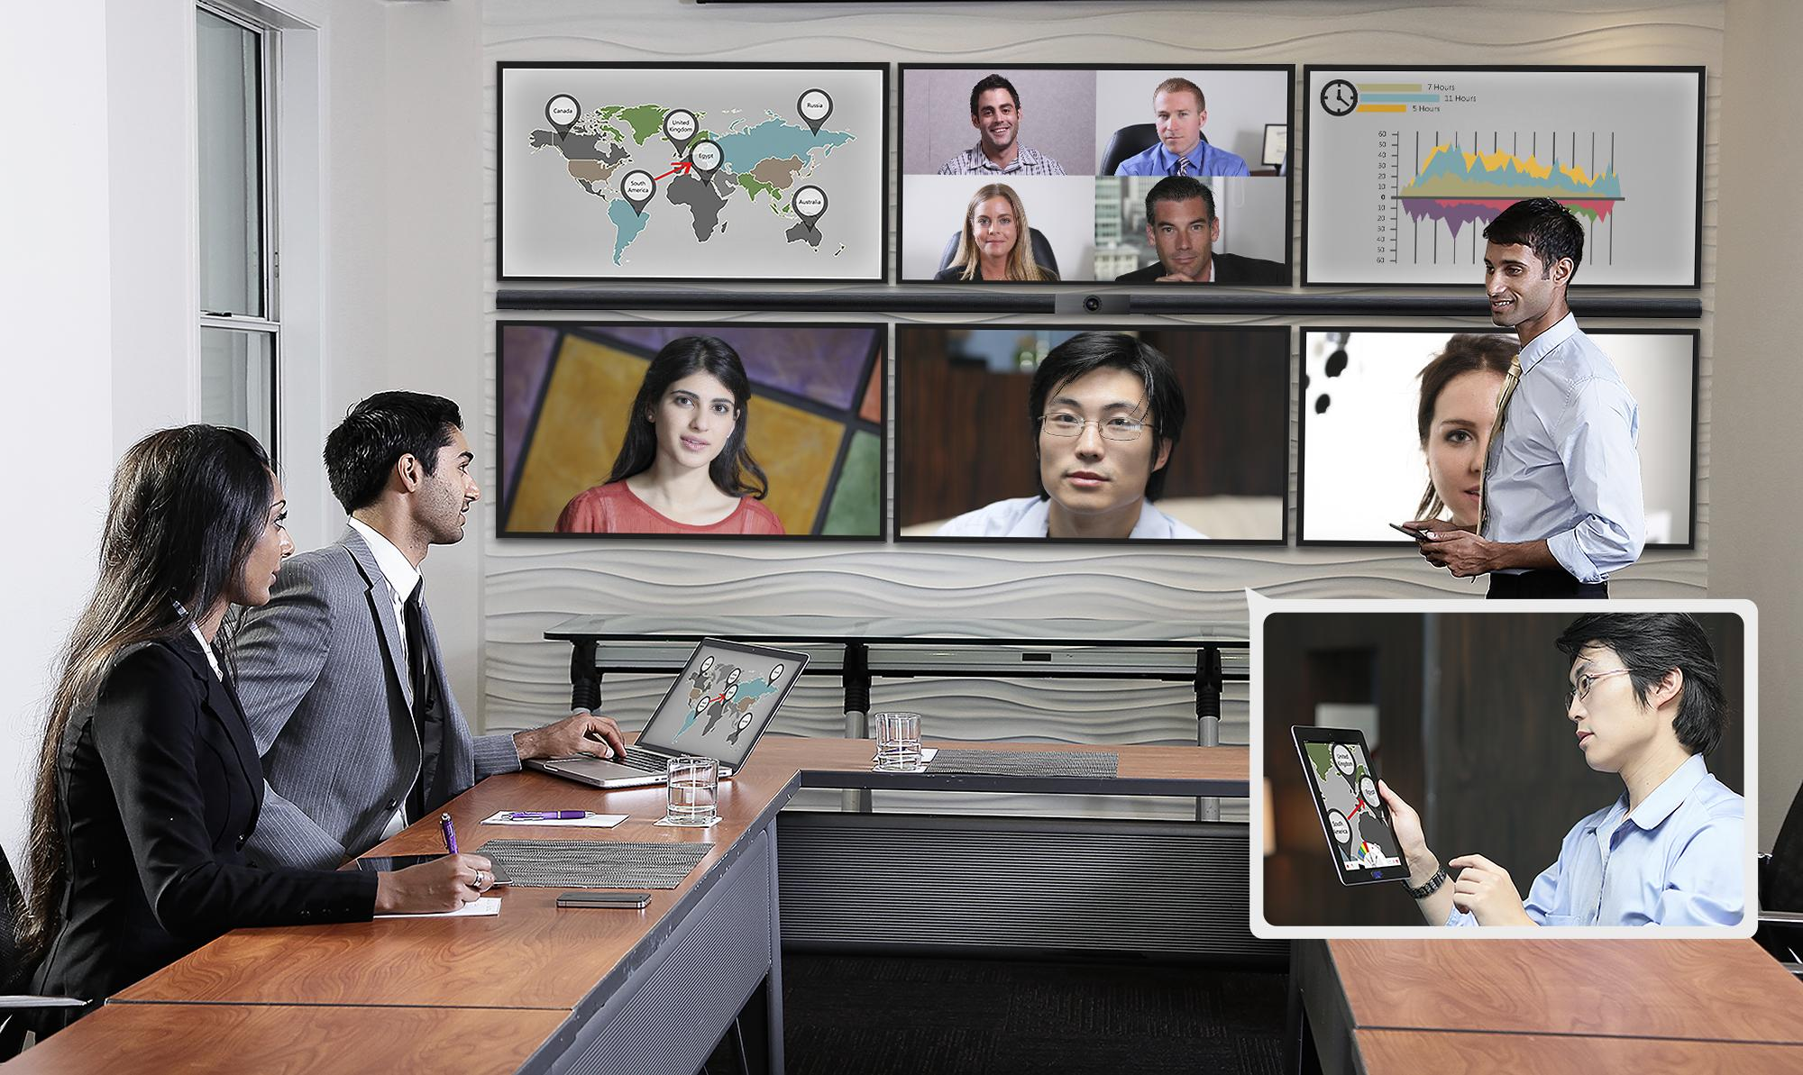
VidyoRoom - VidyoPanorama 600
Up to 6 screens of any size at up to 1080p@60 resolution from a 1u appliance
Each screen can display a full-screen participant, shared content, or up to 8 participants in continuous presence
Conference with all types of endpoints, including room systems, desktops, laptops, tablets, and mobiles
Dynamic adaption technologies optimize each video stream to gracefully conceal and then recover from network errors
 | VidyoPanorama 600 – VP600
HD Encoding | 1080p60
HD Decoding | 1080p60 up to Six Screens
No. Screens | Up to Six
Content Sharing | 1080p30 (native)
Notes:
Video 2

Slide 26
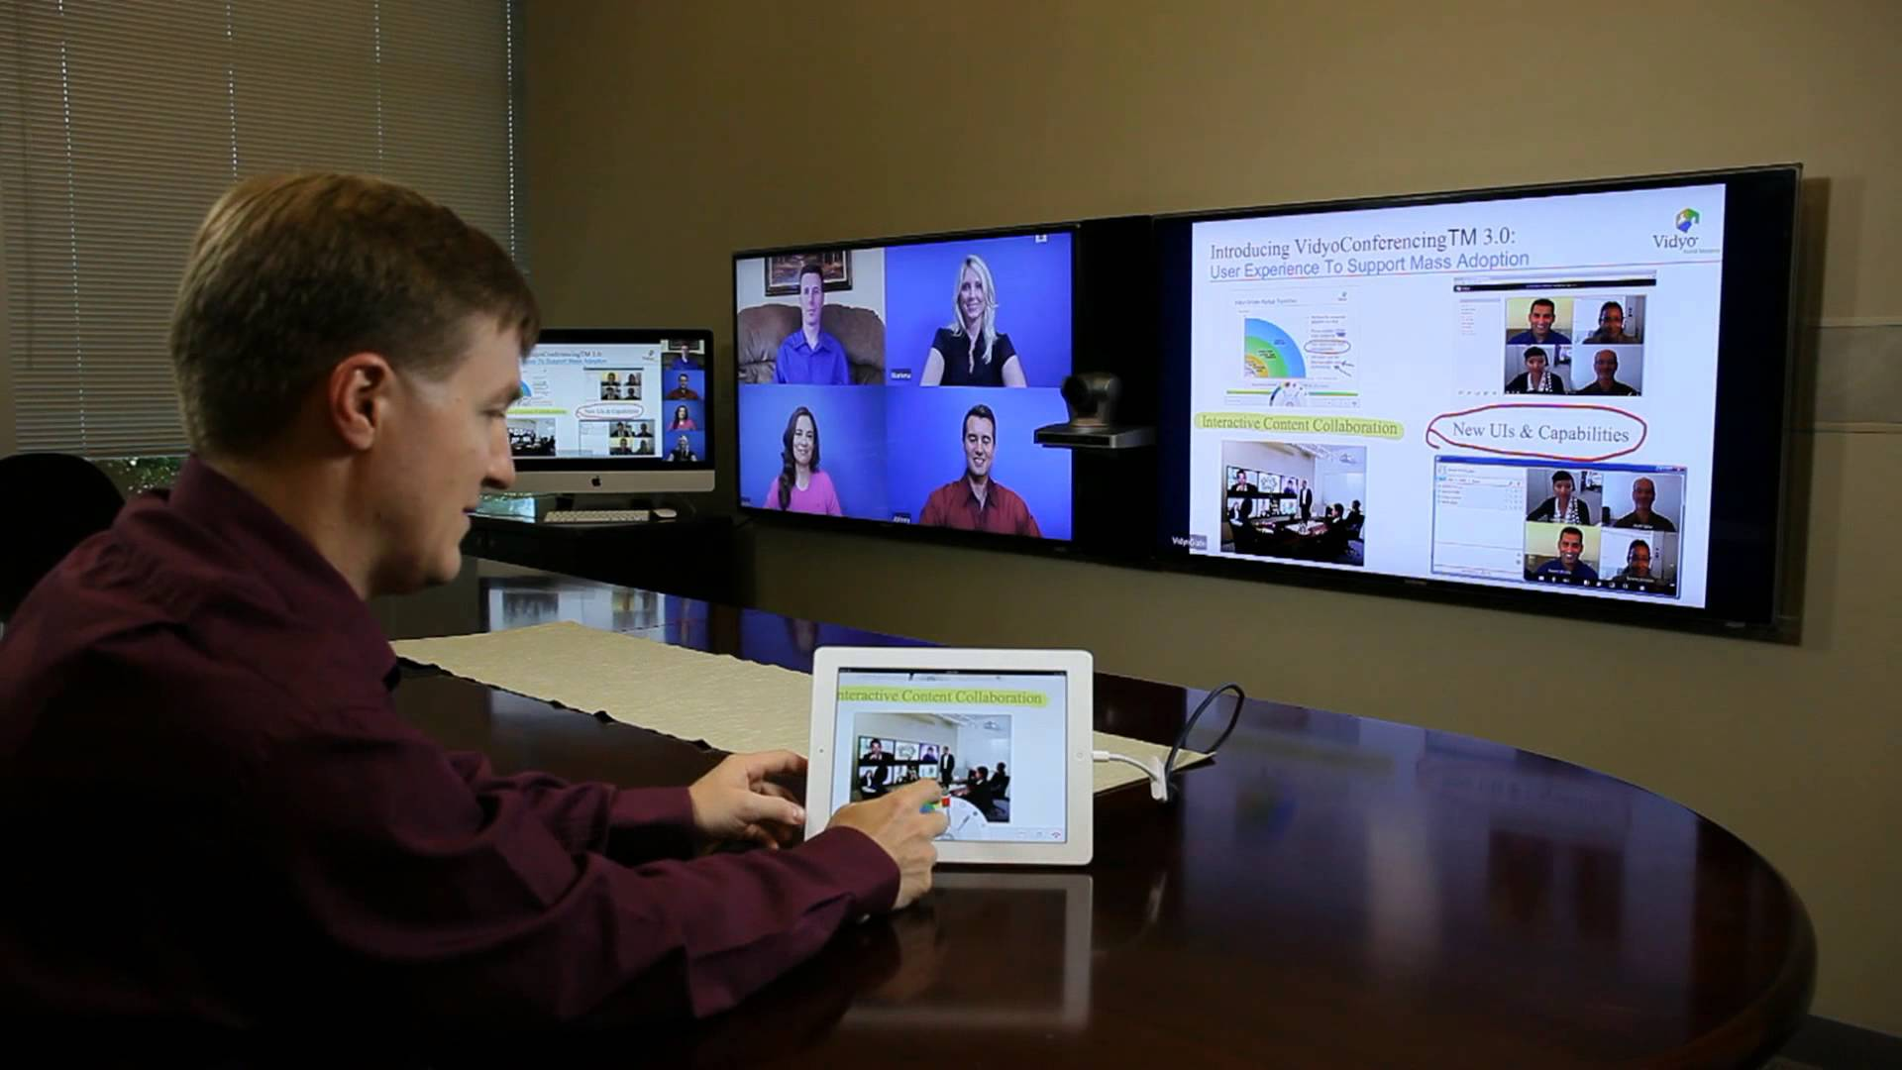
Vidyo Endpoints - VidyoSlate
Free iOS application
Share content from your tablet
View Shared content
Create notes and annotations
Draw on whiteboards

Slide 27
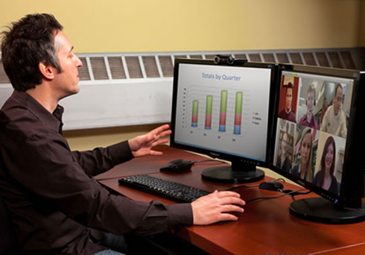
Vidyo Endpoints - Screen and Application Sharing
Share HD quality content
All participants can share concurrently
Data can be unhinged into a separate window
View in preferred mode or in continuous presence
Share full desktop or specific application
Supports H.239 via VidyoGateway
Notes:
Video 2

Slide 28
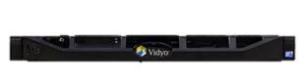
VidyoConferencing Infrastructure
VidyoPortal™
VidyoRouter™
VidyoGateway™
VidyoReplay™

Slide 29
Vidyo - Licensable Resources
Resource | Description
Installs | A one-time license fee that is consumed by the VidyoPortal for VidyoDesktop and VidyoMobile endpoints when joining a call for the 1st time
Seat | A user account on the VidyoPortal
Line | Available connections for VidyoDesktop and VidyoMobile end points
Executive | A licensed account type that uses a reserved line and does not count towards your pool of lines
VidyoPanorama | A licensed account type that is reserved for the original VidyoPanorama systems. The new VidyoPanorama 600 system will use VidyoRoom as its account type, which does not require licensing
Notes:
Video 4

Slide 30
Vidyo - Licensable Features
Feature | Description
Multi-tenant | Allows hosting multiple companies (or departments) on a single VidyoPortal, each having their own unique tenant URL
AES Encryption | An option that encrypts the data/media being sent within the Vidyo infrastructure by using the 128-bit AES encryption standard.
UC Client | Universal Communications client is a licensable feature that allows you to integrate MS Lync/OCS, Adobe Connect and IBM Sametime with Vidyo.
Hot Standby | Automated failover feature for two VidyoPortals
User API | Allows access to Vidyo’s Application Programming Interface to customize the VidyoPortal’s user interface.
Admin API | Allows access to Vidyo’s Application Programming Interface to customize the VidyoPortal’s admin interfaces.

Slide 31
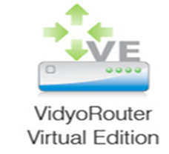
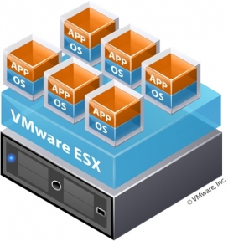

Vidyo - Virtual Editions (VE)
Virtual editions of our VidyoPortal, VidyoRouter and VidyoGateway are available
Virtual appliance is equivalent to physical appliance
Runs in VMware environments
Benefits: On-demand deployment and scale
Use deployed servers
Video conferencing becomes just another enterprise app
Ease of scale and disaster recovery
Small VM compute usage: No transcoding
No new hardware certifications, shipping & logistics
No trip necessary to the data center

Slide 32
VidyoPortal – General Overview
Web-based management for point-to-point and multipoint communication
Provides a consistent user experience for all endpoints
Controls and manages licensed VidyoLines
Combines ease of use with feature rich conferencing environment
VidyoPortal™
Notes:
Video 3

Slide 33
VidyoPortal - Model Capacities
 | Lines | Tenants | Seats (User Accounts) | Active Users (Online)
VidyoOne | Up to 20 | 1 | 100 | n/a
VidyoPortal | Up to 50* | Up to 100 | 10,000** | 2500
VidyoPortal VE | Up to 50* | Up to 100 | 10,000** | 2500
VidyoPortal XL | Up to 50* | 100+ | 50,000** | 2500+
* Up to an additional 100 line capacity with each standalone VidyoRouter
**Please contact your sales associate to increase beyond this capacity
Notes:
Active users clarify
How many active can you increase to with xl

Slide 34
VidyoRouter – General Overview
Routes video and audio streams between endpoints with optimal efficiency
Adds additional capacity to an existing VidyoConferencing system
No transcoding! All encoding and decoding occurs at the endpoints
Intelligently identifies and adjusts to bandwidth limitations, network constraints and display parameters
VidyoRouter™
Notes:
Online course says that you get 150

Slide 35
VidyoRouter - Model Capacities
 | Lines
VidyoRouter VE 25 | 25
VidyoRouter VE 100 | 100
VidyoRouter | 100
VidyoRouter XL | 150
VidyoRouter™
Notes:
Fault taulerence and ha
What version of linux - Vidyo

Slide 36

VidyoProxy – General Overview
Automatic firewall detection and traversal solution
Server component included with VidyoRouter
Client component included with VidyoDesktop and VidyoMobile
VidyoDesktop negotiates UDP ports with VidyoRouter
If needed, VidyoProxy tunnels on port 443
Notes:
Vidyo 3

Slide 37
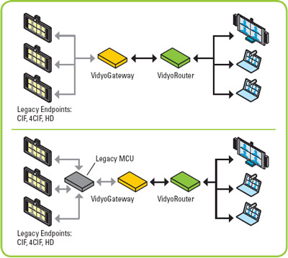
VidyoGateway – General Overview
Provides interoperability between Vidyo endpoints and legacy endpoints (e.g. Polycom, Cisco, Tandberg, Lifesize, etc.)
Supports clustering and a wide range of legacy video & audio standards - H.323, SIP, H.264, H.239, H.263, G.722, G.711
Notes:
Video 3

Slide 38
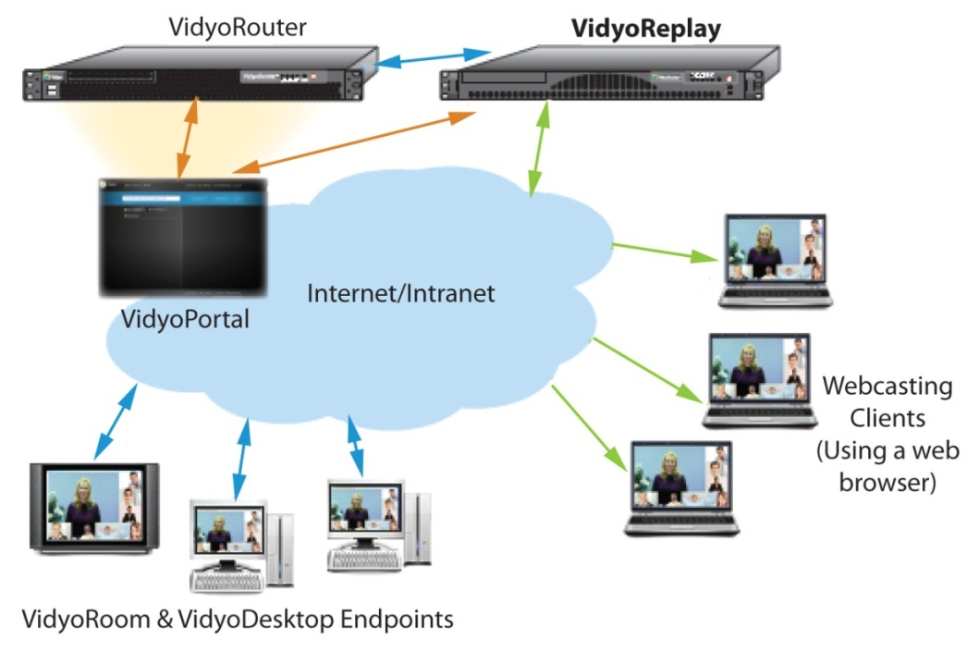
VidyoReplay – General Overview
Hardware appliance that allows you to record up to 2500 hours of HD video
Simultaneously webcast Vidyo conferences to large audiences (up to 300)
Webcast and record in a standard, MP4 format (viewable via web browser)
Every Vidyo endpoint can be set up to record and webcast conferences
Notes:
Video 3

Slide 39
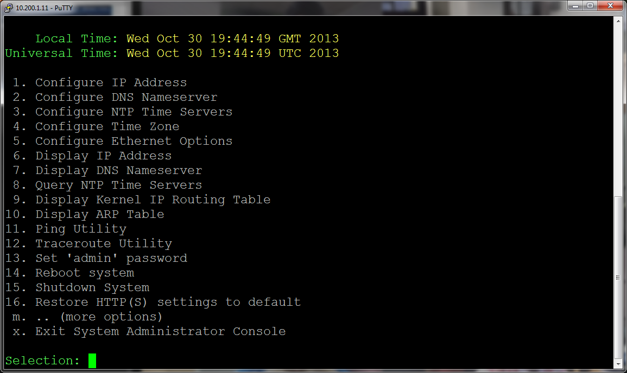
VidyoPortal Initial Setup
Notes:
Video 2

Slide 40
VidyoPortal - Initial Setup Training Objectives
List and describe deployment requirements
Set the VidyoPortal’s IP/DNS settings
Upload and activate the VidyoPortal’s licenses
Configure basic tenant settings
Create a user account
Conduct a test call

Slide 41
Pre-setup – How to approach deployment
Upon receiving equipment and licenses, make sure that the following items have been done to ensure a smooth deployment
All FQDN are registered in the local DNS server (May need several for multi tenant)
All public FQDN’s are registered public DNS servers
All ports listed in the NAT/Firewall Traversal document are open and tested
IP addresses have been reserved for each component
Network information
Hostname
Subnet Mask
Default Gateway
Primary DNS
Secondary DNS

Slide 42
VidyoPortal - Admin Console using Local Connection
Setup physical connections:
Connect the power cord to the server and plug in to power outlet.
Connect VGA display to VGA port in rear or server.
Connect USB keyboard to any of the USB ports or the PS2 port
Connect the server to your network using an Ethernet cable
Be sure to use the Ethernet port0 on the back of the server closest to the power supply (on the left when looking at the unit from the rear)
Power on the server by pressing the power button located on the front of the unit.
Once booted, press the enter key on the keyboard to get the login prompt:
DEFAULT LOGIN CREDENTIALS
username: admin
password: password

Slide 43
VidyoPortal - Admin Console using Remote (SSH)
Connecting the system and setting network information:
Launch SSH client (e.g. PuTTY)
Enter host name (IP address) of the VidyoPortal
Set the port to ‘2222’
Click Open
DEFAULT LOGIN CREDENTIALS
username: admin
password: password
PLEASE CHANGE YOUR PASSWORD TO THE FOLLOWING:
Password: P@ss001

Slide 44

Trainer Demo
During this demo, the trainer will demonstrate the following:
Accessing the VidyoPortal’s Administrator Console Menu
Configuring the VidyoPortal with IP and DNS settings
Testing to make sure that the VidyoPortal’s FQDN is resolving correctly by accessing the VidyoPortal’s FQDN with a browser and seeing the VidyoPortal login page.
CHECK THIS OUT!

Slide 45
VidyoPortal Initial Setup - Lab Exercise #1a
Use the provided lab exercise document to complete the following objectives:
SSH to the VidyoPortal
Configure VidyoPortal with the assigned IPN / DNS settings for your group

Slide 46
Upload and Activate Licenses
VidyoLicenses are required in order to turn on a VidyoPortal
Uploading and activating your licenses on VidyoPortal version 3.x and later consists of the following easy steps:
Upload v3 license file and click Save.
Uploading and activating your licenses on VidyoPortal version 2.x to 2.3.x consists of the following easy steps:
Upload VM file and click Save
Upload SYS file and click Save
(On version 2.X systems and earlier) Enter token from *.txt file and click Save.
In addition to the token, the *.txt file contains what licensed resources and features were purchased

Slide 47
VidyoPortal - Configuring Basic Tenant Settings
Tenant Name (e.g. Vidyo)
Tenant URL (e.g. main.vidyo.com)
Allocate tenant resources (e.g. seats, ports/lines, installs, executives)
Item | Description
VidyoLine | A licensable resource that allows a VidyoDesktop and VidyoMobile end point to connect to a video conference.
Seat | An endpoint user account. All Vidyo endpoints require a seat.
Install | A ‘one-time’ mandatory installation fee that is consumed by all VidyoDesktop and VidyoMobile end points when connecting to a VidyoPortal for the 1st time.
Executive | This is a licensed account type that does not consume a VidyoLine.
Panorama | A licensed account type that is reserved for VidyoPanorama systems.

Slide 48
Trainer Demo
During this demo, the trainer will demonstrate the following:
Logging into the Super Admin interface
Uploading and activating licenses
Configuring basic tenant settings
CHECK THIS OUT!

Slide 49
VidyoPortal - Initial Setup Lab Exercise #1b
Use the provided lab exercise document(s) to complete the
following objectives:
Log into the VidyoPortal’s Super Admin interface
Upload and activate licenses
Configure basic tenant settings
Tenant name
Tenant URL
Ports/Lines, Seats, Installs

Slide 50
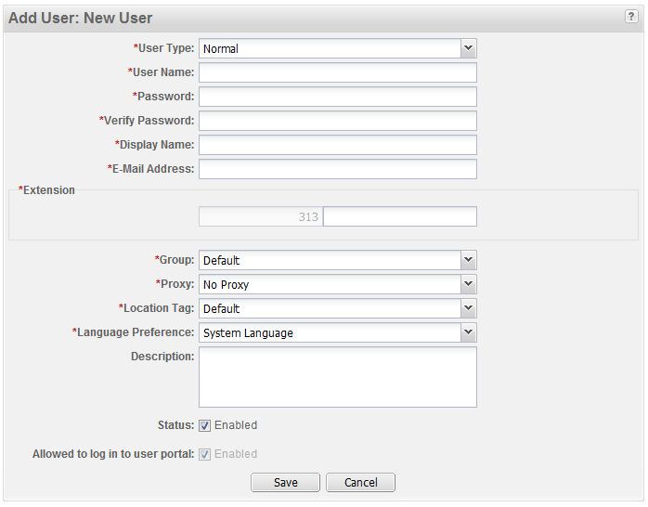
VidyoPortal - Creating a User Account
Log into the Admin interface, click the ‘Add User’ option and fill out the required fields.

Slide 51
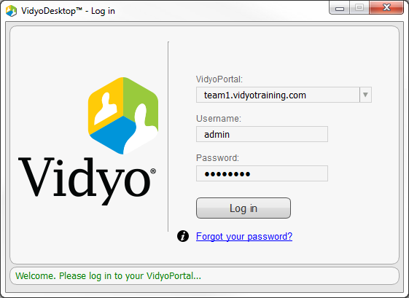
VidyoPortal - Signing in for the First Time
After account creation, navigate to the tenant URL and download the client.
Once downloaded, launch the VidyoDesktop client
Enter Tenant FQDN in the VidyoPortal field
Enter Username and Password
Press “Log in”

Slide 52
Trainer Demo
During this demo, the trainer will demonstrate the following:
Creating a user account
Signing into the VidyoPortal
Conducting a test call
CHECK THIS OUT!

Slide 53
VidyoPortal - Initial Setup Lab Exercise #1c
Use the provided lab exercise document to complete the
following objectives:
Create a user account
Sign into a VidyoPortal
Conduct a test call (join your room)

Slide 54

VidyoPortal - Initial Setup Finish Line
Congratulations! You are now able to:
Set the VidyoPortal’s IP/DNS settings
Upload and activate the VidyoPortal’s licenses
Configure basic tenant settings
Create a user account
Conduct a test call

Slide 55
VidyoPortal - Initial Setup Reference Materials
Topic | Document Name
Server Initial Setup | Vidyo Server Getting Started Guide
System Administrator Console | VidyoConferencing Admin Guide
How to Upload and Activate Your System Licenses | VidyoConferencing Admin Guide
How to Add a New User | VidyoConferencing Admin Guide

Slide 56
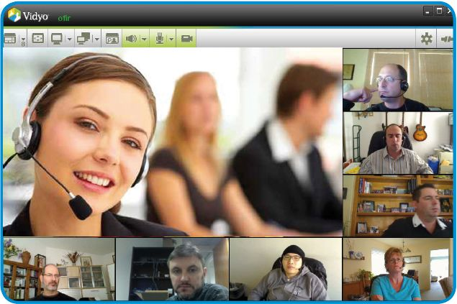
VidyoPortal/VidyoDesktop User Features
Notes:
Video 2

Slide 57
VidyoPortal – User Features
As an End User, you may:
Sign-in securely
Select a language
Start your own meeting
Join a meeting
Place a direct call to an online user in the system
Easily search for any user by typing the name in the form field
Control a meeting
Send invite Email
Manage personal “My Contacts” list
Edit personal account and set your preferences

Slide 58
VidyoPortal - User Access
Users launch the VidyoDesktop client
Enter Tenant FQDN in the VidyoPortal field
Enter Username and Password
Press “Log in”

Slide 59
VidyoDesktop - Client Features
Software-based and downloadable for Windows XP/Vista/Win7, Mac OS X and Linux
Automatic device selection
Software echo cancellation
Encodes and decodes up to HD
Share content (e.g. application window or entire display)
Video ‘Privacy’ mode turns off own camera while in conference
Control screen layouts, orientation and size
Full screen support
Control number or viewable participants (up to 8)
‘Preferred’ and ‘Non-Preferred’ Modes
View other user’s shared application – docked or on a separate window
Toggle between different shares
Audio controls
speaker volume and mute
microphone level and mute

Slide 60

VidyoDesktop - System Tray/Dock Icon
VidyoDesktop runs automatically when the user logs into Windows/Mac
Icon appears in notification area, also known as “system tray”, dock, when VidyoDesktop is running
Right-clicking on the icon will give a context menu, allowing the user to configure or quit VidyoDesktop, Start a Meeting in their Room, or open the Portal UI to call another User.
Notes:
‹#›

Slide 61
Trainer Demo
During this demo, the trainer will demonstrate the following:
VidyoDesktop installation
Provide a tour of the VidyoPortal user interface
Edit contacts
Join a room
Review Control Meeting options
CHECK THIS OUT!

Slide 62
VidyoPortal/Desktop - Features Lab Exercise #2
Use the provided lab exercise documents to complete the following objectives:
Sign-in to VidyoPortal
Join a room
Search for and join a specific conference room
Use VidyoDesktop to perform the following:
Share content
View shared content
Change layout
Mute mic, camera, and speaker
Adjust VidyoDesktop settings

Slide 63
VidyoPortal/Desktop - User Features Finish Line
Congratulations! You are now able to:
Join/host a video conference
Change the layout and settings of VidyoDesktop
Control a meeting

Slide 64
VidyoPortal/Desktop - User Features Reference Info
Topic | Document Name
VidyoDesktop Recommended/Minimum Requirements | VidyoConferencing Admin Guide
General Usage | VidyoPortal and VidyoDesktop User Guide

Slide 65

VidyoPortal Administration
Notes:
Video 2

Slide 66
VidyoPortal – Administration Training Objectives
List and describe the capabilities of the Super Admin vs. Admin
List and describe Vidyo’s account types
Access the Super Admin and Admin Interfaces
Perform common Super Admin and Admin tasks

Slide 67
Vidyo - Administrator Account Types
Super Admin – Primary account for installing, configuring, and maintaining system
Multiple super admin accounts are allowed
Admin (aka Tenant Admin) - Manages user accounts and limited, tenant-specific settings
Multiple admin accounts are allowed per tenant.
The Super Admin signs into the ‘Super Admin’ interface
e.g. https://main.vidyo.com/super
The Admin(s) sign into the ‘Admin’ interface
e.g. https://main.vidyo.com/admin

Slide 68
Vidyo - Account Types
Privilege | Super Admin | Admin | Operator | Normal, VidyoRoom and Executive
Manage Global System Settings
Conduct System Maintenance
Manage User Accounts
Manage/Control Meeting Rooms
Manage Group Settings
Join/Host Video Conferences
*The Super Admin can log into the /admin url to posses admin privileges

Slide 69
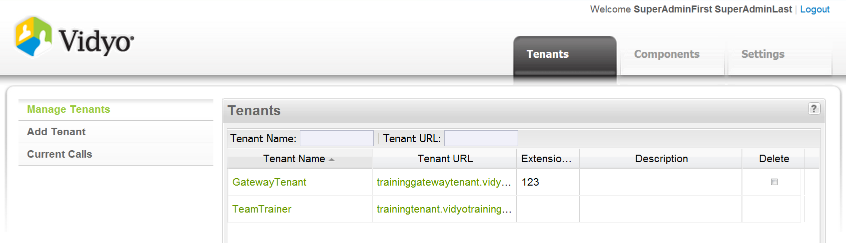
Super Admin Interface - /super Breakdown
Tab Name | Functionality
Tenants | Tenant Wizard
Components | Configuration of VidyoRouters, VidyoGateways, VidyoReplays, and VidyoCloud
Settings | Global system and maintenance settings

Slide 70
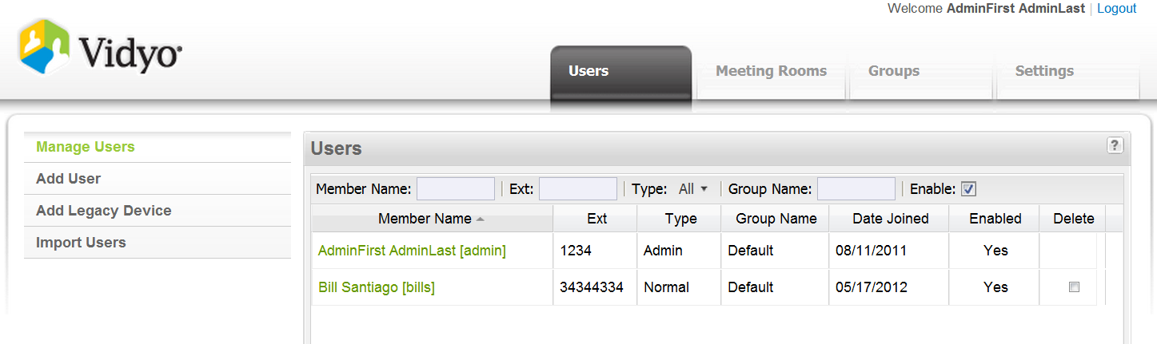
Admin Interface - /admin Breakdown
Tab Name | Functionality
Users | Add/remove user accounts and legacy devices
Meeting Rooms | Add/remove meeting rooms and control meetings
Groups | Group settings: max send/receive bandwidth, max participants in a conference and VidyoReplay privileges.
Settings | Tenant specific system settings

Slide 71
Super Admin /super, Admin /admin - System Settings
Task | Super Admin Interface | Admin Interface
Manage tenant settings
Manage System Components
View Platform Network Settings
Apply System Licenses
Backup/Restore/Upgrade/Restart VidyoPortal
Enable/disable SSL
Enable CDR Access

Slide 72
Super Admin /super, Admin /admin - User/Interface Settings
Task | Super Admin Interface | Admin Interface
Create Users/Meeting Rooms
Create/Edit Groups
Control Meeting
Upload Endpoint Software
Customize About Info, Contact Info and Invite Text
Customize VIdyoPortal Super/Admin AND User Portal Logo

Slide 73
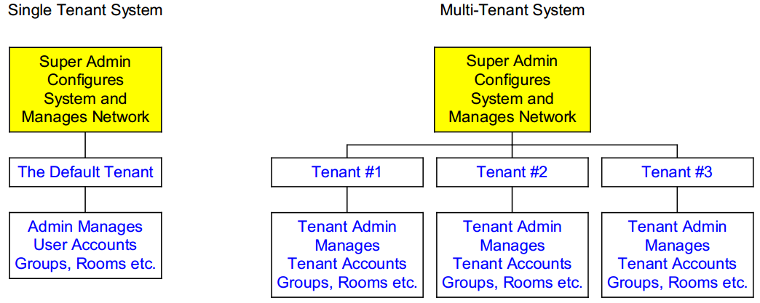
Super Admin / Admin - Hierarchy

Slide 74
Trainer Demo
During this demo, the trainer will demonstrate the following:
Provide a tour of the features that are available in the Super Admin and Admin interface.
CHECK THIS OUT!

Slide 75
VidyoPortal - Administration Lab Exercise #3
Use the provided lab exercise document(s) to complete the following objectives:
Conduct a database backup
Set Super Admin email address (account and Notifications)
Create a group with the following settings:
2Mb send and 2Mb receive bandwidth limitation
20 max participants
Enable new account email notifications
Create a public meeting room called ‘Conference Room A’ with a room PIN set to ‘1234’

Slide 76
VidyoPortal - Administration Finish Line
Congratulations! You are now able to:
List and describe the capabilities of the Super Admin vs Admin
List and describe Vidyo’s account types
Access the Super Admin and Admin Interfaces
Perform common Super Admin and Admin tasks

Slide 77
VidyoPortal - Administration Reference Materials
Topic | Document Name | Page(s)
Super Admin Interface | VidyoConferencing Admin Guide | 17
Admin Interface | VidyoConferencing Admin Guide | 82

Slide 78
Standalone VidyoRouter Setup
Notes:
Video 2

Slide 79
VidyoRouter - Setup Training Objectives
Determine whether or not you need a standalone VidyoRouter
Set the VidyoRouter’s IP/DNS settings
Set the VidyoRouter’s config server address
Conduct a test call

Slide 80
VidyoRouter - Do I need a Standalone VidyoRouter?
You’ve exceeded the max 50 concurrent endpoint connections that is supported by the VidyoPortal’s embedded VidyoRouter
You have a remote site that is using Vidyo and you want to minimize your primary site’s WAN bandwidth utilization (assuming that your VidyoPortal is installed at your primary location).
You want to secure your Vidyo solution by placing a VidyoRouter on the inside (LAN or DMZ) and outside of your network.

Slide 81
Trainer Demo
During this demo, the trainer will demonstrate the following:
Set up a standalone VidyoRouter
Disable the embedded VidyoRouter
Conduct a test call
CHECK THIS OUT!

Slide 82
Standalone VidyoRouter – Setup Lab Exercise #4
Use the provided lab exercise document(s) to complete the following objectives:
Set the VidyoRouter’s IP/DNS settings
Set the VidyoRouter’s config server address
Disable the embedded VidyoRouter
Conduct a test call

Slide 83
Standalone VidyoRouter - Setup Finish Line
Congratulations! You are now able to:
Set up a standalone VidyoRouter

Slide 84
Day One Review - Lab Exercise #5
Use the provided lab exercise document(s) to complete this exercise:
Set up VidyoPortal
Set up Standalone VidyoRouter
Conduct a test call

Slide 85
VidyoProxy Setup and Use

Slide 86
VidyoProxy - Vidyo Call Flow
VidyoPortal
Web Services
HTTP/HTTPS: 80/443
VidyoManager
RMCP(S): 17991
VidyoDesktop Endpoint
EMCP(S): 17992
VidyoRouter
SCIP(S): 17990
UDP (6 ports): 50000 - 65535

Slide 87

VidyoProxy - Proxy Mechanism
Only EMCP signaling is routed via the VidyoProxy that is assigned to the user.
SCIP and Media will traverse the router that they are placed on either by VidyoCloud rules or default routing logic.
VidyoRouter 1
EMCP
VidyoManager
v2.2 +
VidyoProxy
VidyoRouter 2
SCIP/Media
VidyoProxy

Slide 88
Trainer Demo
During this demo, the trainer will demonstrate the following:
Completing the VidyoProxy Setup
Conducting a test call using VidyoProxy
CHECK THIS OUT!

Slide 89
VidyoProxy Setup - Lab Exercise #14
Use the provided lab exercise document to complete the following
objectives:
Set up the VidyoProxy
Assign the VidyoProxy to your account
Enable the ‘Always Use VidyoProxy’ option within VidyoDesktop’s configuration settings
Conduct a test call to see if VidyoProxy is working properly

Slide 90
Day One Finish Line
Congratulations! You are now able to:
Set the VidyoPortal & VidyoRouter IP/DNS settings
Upload and activate the VidyoPortal’s licenses
Configure basic tenant settings
Create a user account
Conduct a test call
Join/host a video conference
Change the layout and settings of VidyoDesktop
Control a meeting
List and describe the capabilities of the Super Admin vs Admin
List and describe Vidyo’s account types
Access the Super Admin and Admin Interfaces
Perform common Super Admin and Admin tasks
Set up a standalone VidyoRouter
Set up VidyoProxy

Slide 91
Thank you!

